Slide 1

ROBOTICS AND AUTOMATION (ECE2008)
REVIEW – 1
SAFETY ASSISTANCE SURVEILLANCE BOT
KARVEANDHAN P, 17BEC0003
S. ARUN KARTHIK, 17BEC0114
MAKADIA SHIV SANJAYBHAI, 17BEC0227

Slide 2
INTRODUCTION
Security aspects are the main focus of the project.
There is a need for high surveillance especially in sensitive areas, military borders, government offices, public places, security check points and even at homes.
A robot can help in outdoor surveillance by monitoring important places and also it can be made to reach suspicious places for close observations.
In risky and dangerous situations such as rescue operations, a robot could be a great help to the rescue team and can greatly improve the safety of the rescue team as well as their working efficiency.
A robot capable of moving in all types of terrain mounted with the camera and sensors can go to the affected area and can provide all the live information to the rescue team, as per the situation the rescue team can plan its activity.

Slide 3
RESEARCH PAPER
Surveillance Robot Using Arduino Microcontroller, Android APIs and the Internet
Proceedings of 2014 First International Conference on Systems Informatics, Modelling and Simulation.
This paper proposes a cost-effective four-wheeled surveillance robot using an Arduino UNO microcontroller and a smartphone running the Android Operating System. Surveillance robots typically consist of a video camera, a GPS module, and GSM radios. Android smartphones come with excellent hardware satisfying the above needs. This can be leveraged and used to advantage through APIs (Application Programming Interfaces) provided for the Android operating system. The robot can be controlled remotely from a PC using the internet and a microcontroller-smart phone interface residing on the robot. To capture and archive the real time video from the robot, the inbuilt camera input of the phone is utilized. The robot can be controlled based on visual feedback from the same smart phone. Four motors help achieve a zero turning radius. The camera is attached to a stepper motor which makes it feasible to capture the scene or object of interest. The captured video can be enhanced and made intelligible using further image processing on the remote PC thereby

Slide 4
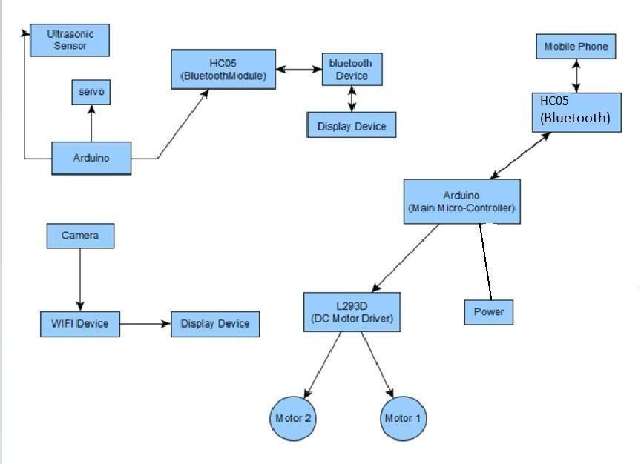
FLOWCHART

Slide 5
OUTCOMES
We have thus developed a robot which can be used for multipurpose applications related to surveillance and security systems
This project offers a lot of scope for adding newer features. Since all image processing is done remotely, there are no resource constraints apart from the bandwidth of the network.
We can program the robot such that it can detect objects and reach them on its own. Thus, we can make it completely autonomous.
Also, with the presence of GPS navigation and mapping software, the robot has the capability of finding the best route possible to reach a certain location.
Also, by making it sturdier and giving it extra protection, we can make it an all terrain robot, which would make it ideal for a surveillance robot.
There is also the option of adding sound processing to the remote computer, thus giving it greater surveillance capabilities.
The possibilities are endless. This robot in its current state provides a platform for further research into improving its capabilities.

Slide 6
REFERENCES
Nádvorník, J. and Smutný, P., 2014, May. Remote control robot using Android mobile device. In Proceedings of the 2014 15th International Carpathian Control Conference (ICCC) (pp. 373-378). IEEE.
Ecemis, M.I. and Gaudiano, P., 1999, November. Object recognition with ultrasonic sensors. In Proceedings 1999 IEEE International Symposium on Computational Intelligence in Robotics and Automation. CIRA'99 (Cat. No. 99EX375) (pp. 250-255). IEEE.
Bokade, A.U. and Ratnaparkhe, V.R., 2016, April. Video surveillance robot control using smartphone and Raspberry pi. In 2016 International Conference on Communication and Signal Processing (ICCSP) (pp. 2094-2097). IEEE.
Hasan, S.M., Rasid, S.M.R., Mallik, A. and Rokunuzzaman, M., Development of a Wireless Surveillance Robot for Controlling from Long Distance.

